Slide 1
COVID19 FACT CHECKER
The Data Detectives:
Dominick Sinopoli, Prosper Anyidoho

Slide 2
Problem Statement
Misinformation during COVID19 has been problematic
Fake news/facts comes from non-accredited sources
While real news/facts comes from accredited sources like the CDC,WHO
False news is mostly fueled by social media
A covid19 fact checker can be used to help identify and stop the spread of fake news/facts
To achieve this goal machine learning algorithms will be applied to a text data set and embedded into a web application

Slide 3
Data Overview
Data from CodaLab Covid19 fake news detector competition
Data gathered from social media platforms: Twitter, Facebook, Instagram. Etc.,
8560 instances; 4080 fake tweets and 4480 real tweets
Data cleaning to remove punctuations, stopwords

Slide 4
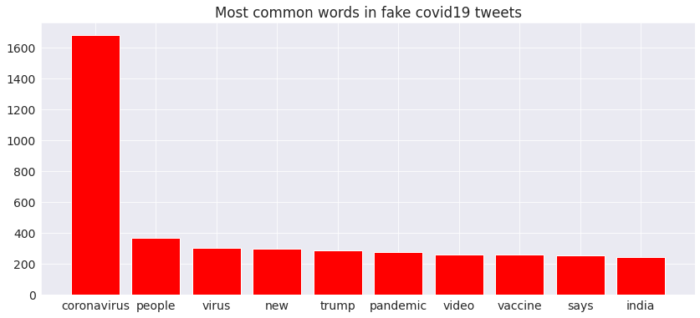
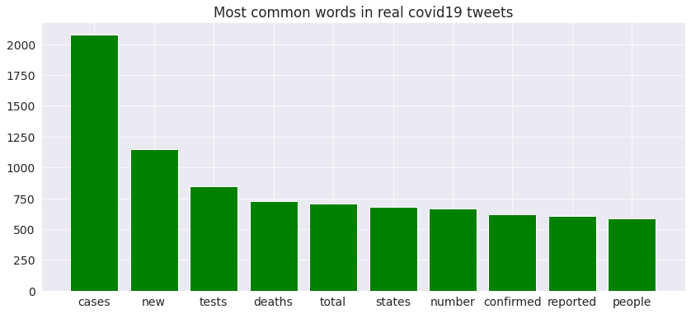
EDA on Tweet Data

Slide 5
Model Design
4080 False and 4480 True instances
Saved 500 False and 500 True for validation set and rest for training
Used an ensemble approach of simplistic models
Chose between Naive Bayes, and Logistic
Each sub-model trained on a random subset of 3000 False instances and 3000 True instances

Slide 6
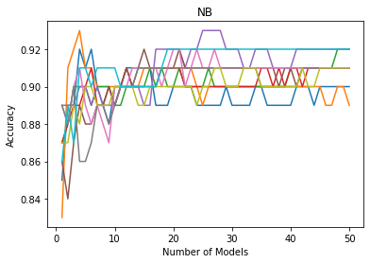
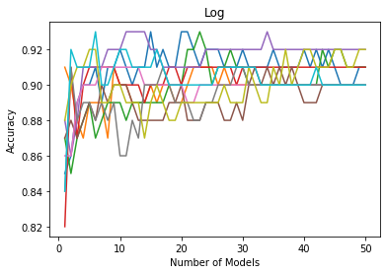
How Many of each?

Slide 7
Did the ensemble approach work?
Accuracy on validation set:
25 Naive Bayes -> 91.4%
35 Logistic -> 93.7%
25 Naive Bayes and 35 Logistic -> 94.1%

Slide 8
Conclusions
Exploring more complicated methods of prediction including neural nets/deep learning
Other data processing techniques like using ngram, tf-idf, and embeddings
Adding more data to generate a more robust data set
Embedding our model into social media or news sites to check for accurate information

